Slide 1

COMP 90049
Knowledge Technologies
Week 3
我们毕业啦
其实是答辩的标题地方
Tutor
Ang Li

Slide 2
Name: Ang Li
E-mail: angl4@student.unimelb.edu.au
Contact information
Research topic: computer vision

Slide 3
Summery
Finishing up Exercise 6 (a)
Work through this week’s exercise
Notes:
Secure File Transfer Protocol
Secure Shell

Slide 4
Exercise 6:
Write a regular expression to solve the following problems:
(a) Match a price like $001.23, $34.1, $010

Slide 5
Exercise 6:
Write a regular expression to solve the following problems:
(a) Match a price like $001.23, $34.1, $010
/\$(0|[1-9][0-9]*)(\.\d{1,2})?/

Slide 6
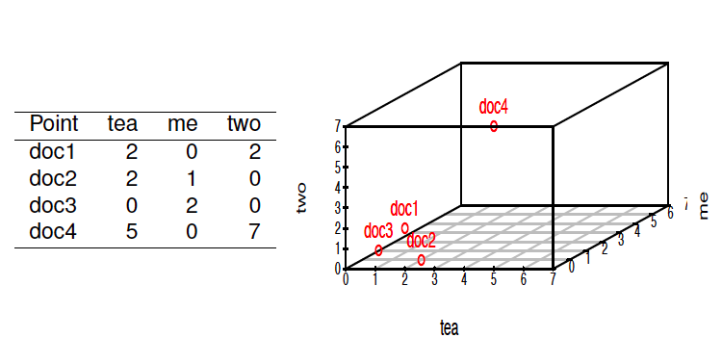
Exercise 2:
What is a vector space model , and why is it useful?

Slide 7
Exercise 2:
What is a vector space model , and why is it useful?
Using a vector space model, we treat an object (“instance") as a combination of properties (“attributes"), where each property corresponds to a separate (orthogonal) “dimension" in a Cartesian co-ordinate space.

Slide 8
This representation is useful because it allows us to represent a complex object in a simplified manner, to expedite the calculation of similarity measures.
In a text processing context, each “instance" is a document, and each “property" is (usually) the occurrence of an individual word. The values that these “features" can take are (usually) either binary (i.e. Is the word present in the document, or not?) or are frequencies (i.e. How many times is the word present in the document?).

Slide 9
Exercise 3:
Consider the following collection of “documents" C :
(i ) It is what it is.
(ii ) Jean's hat is finer than Karl's hat.
(iii ) We are obsessing about gene issues.
Build a vector space model for this collection.

Slide 10
Step 1: pre-processing
Note that different choices in pre-processing would lead to different vector space models.
Here we mainly:
Transform all words to lower case
Remove punctuation
Remove ‘s

Slide 11
Step 2: generate the word list
Here's the word list (of 14 elements), which will correspond to each element in the vectors below:
about, are, finer, gene, hat, is, issues, it, jean, karl, obsessing, than, we, what

Slide 12
Step 3: build the vector space model
Here's the word list (of 14 elements), which will correspond to each element in the vectors below:
about, are, finer, gene, hat, is, issues, it, jean, karl, obsessing, than, we, what
(i): 0,0,0,0,0,2,0,2,0,0,0,0,0,1
(ii): 0,0,1,0,2,1,0,0,1,1,0,1,0,0
(iii): 1,1,0,1,0,0,1,0,0,0,1,0,1,0

Slide 13
Exercise 4:
Use a model to decide which of the sentences in C is most similar to the following sentence:
(iv) Karl is obsessed with genes.

Slide 14
Exercise 4:
The first thing to do is to represent this document in the same format as the documents above. You'll notice that we have an immediate problem here, because three of these (five) words aren't in our word list above (because we haven't seen them yet!).
To make my life a little easier, I'll tack them on at the end, so that the vectors above just need 3 more zeroes on the right-hand side.

Slide 15
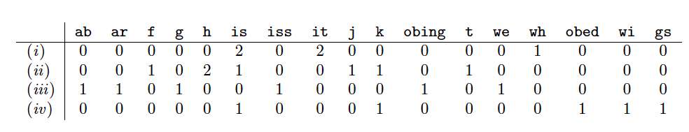
Exercise 4:

Slide 16

Exercise 4:
(a) Jaccard similarity
Recall that the denition of Jaccard similarity is:
Here, we are using set intersection, so that we don't care about the frequencies of words, only their presence or absence.

Slide 17
Exercise 4:
For (i ), the two sentences only have a single word in common (is; you can confirm this by looking for elements that are non-zero in both vectors). The union of the two sentences is the count of all of words that occur in either sentence: this is 7. All in all, the similarity is 1/7 .
For (ii ), there are two words in common (karl and is). There are 9 words in the union, for a similarity of 2/9 .
For (iii ), 0.
All in all, (ii ) is the most similar.

Slide 18
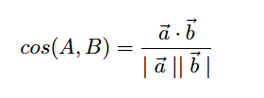
Exercise 4:
(b) Cosine similarity
Recall that the formula for cosine similarity is as follows:

Slide 19
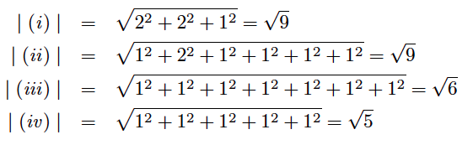
Exercise 4:
The length of a vector is found by taking the square root of the sum of the squares of its entries. Leaving out the 0 terms, the vector lengths are as follows:

Slide 20
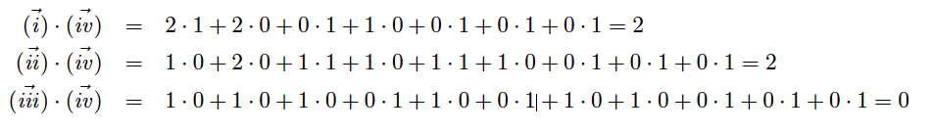
Exercise 4:
We find the dot product by adding up the products of the values for each of the corresponding elements:

Slide 21
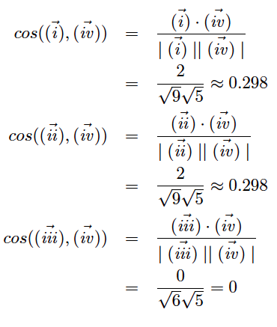
Exercise 4:

Slide 22
Exercise 5:
If we wished to estimate the value of P (apple; fruit ) based on the data above, we might arrive at the value
2/4, or the value 9/36
(a) What do each of these probabilities correspond to? Explain the model that underlies each of these interpretations.

Slide 23
Exercise 5:
If we wished to estimate the value of P (apple; fruit ) based on the data above, we might arrive at the value
2/4, or the value 9/36
(a) What do each of these probabilities correspond to? Explain the model that underlies each of these interpretations.
2/4 refers to the document-based model; i.e. how many of the 4 documents are fruit, and contain (at least one) apple?
9/36 refers to the term-based model; i.e. how many of the tokens that we have seen (36 in total) are apple in fruit documents?

Slide 24
Exercise 5:
(b) Which of these do you think would be more useful, if we wished to use these probabilities to help predict the labels of unknown documents?

Slide 25
Exercise 5:
(b) Which of these do you think would be more useful, if we wished to use these probabilities to help predict the labels of unknown documents?
The document-based model is preferred.
Our objective here is to predict the labels of documents; therefore, our model should be based around documents.
The term-based model is sensitive to the actual values that we have in our dataset; if there was some instance with disproportionately large values.

Slide 26

Exercise 6:
Calculate the entropy of the distribution of the label attribute, based on the data above.
Recall that the entropy (in bits) of a distribution is dened as:
Here, we are interested in the distribution of the label attribute, which takes two values: fruit and comp.

Slide 27
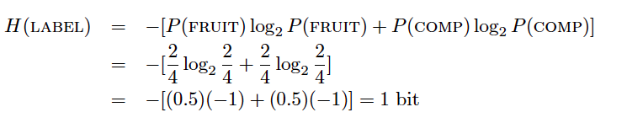
Exercise 6:
Calculate the entropy of the distribution of the label attribute, based on the data above.
We begin by calculating the probabilities of the events: P (fruit ) = 2/4 and P (comp ) = 2/4

Slide 28
Thanks!

